Slide 1
Protecting Your Children
What Parents Need To Know About Bullying
Tracey D. Messinger, M.S. Ed.
Cyberbullying
English

Slide 2
Housekeeping

Slide 3
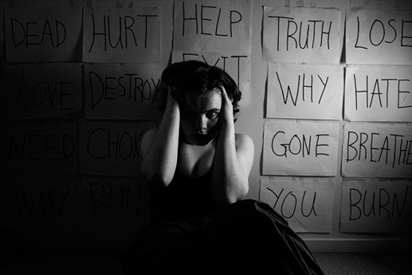
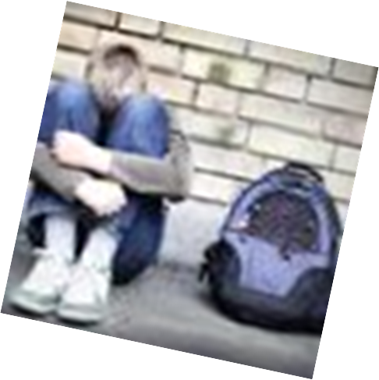
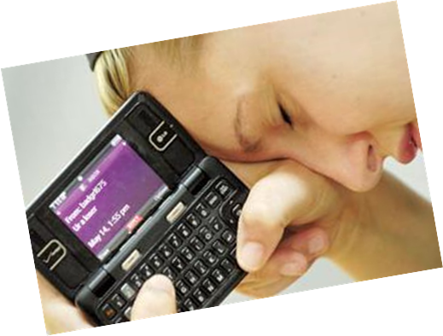
Characteristics of Students Who Are Bullied
Emotional
Physical
Social
Academic
Attendance
Notes:
Ask participants to share what they know, fill in other missing characteristics. Generate list under each category

Slide 4
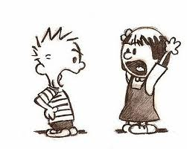
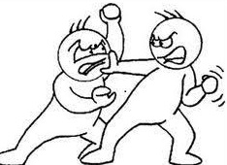
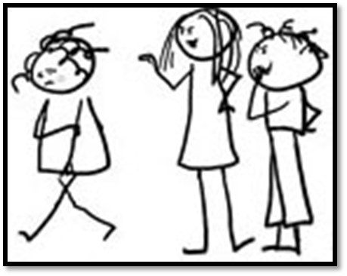
Characteristics of Students Who Bully
Aggression
Manipulation
Lack of empathy
Blames others
Doesn’t take responsibility for actions or behaviors
Exposed to bullying or aggression at home
Concerned about reputation
Feels justified

Slide 5
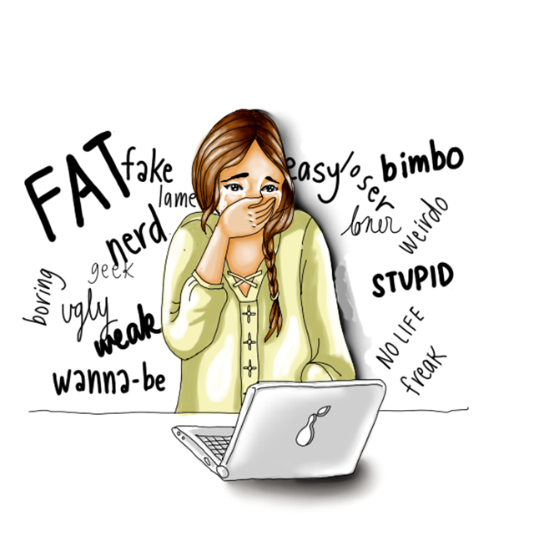
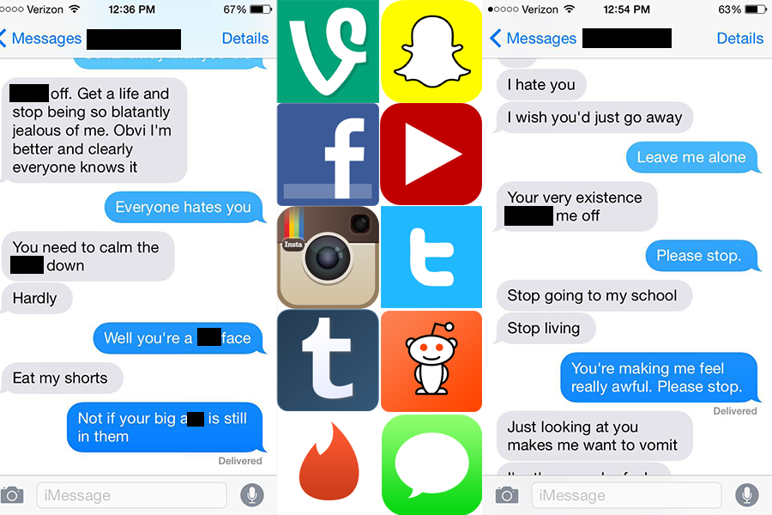
Cyber Threat
Texting, social media, emails
Fake Profiles
Anonymous
Chat Rooms
Mass texts or emails
Sexting
Rumors, lies, photo shopped pics

Slide 6
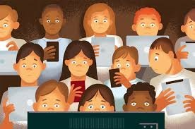
Statistics on Cyberbullying
40% threatened on line
1 in 4 students have experience more than once
32% of parents stop supervising students online after age 11
Notes:
Girls are 2x more targets and perpetrators of cyber bullying
40% of students threatened on line
1 in 4 students have experience more than once
32% of parents stop supervising students online after age 11

Slide 7
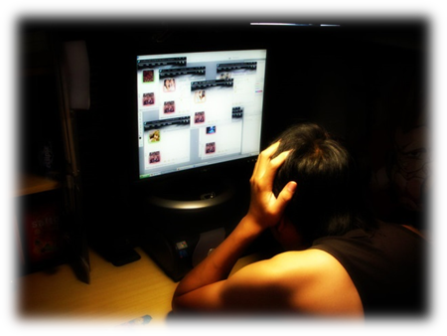
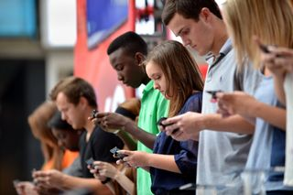
What is Cyberbullying?
Texting, social media, emails
Fake Profiles
Anonymous
Chat Rooms
Mass texts or emails
Sexting
Rumors, lies, photo shopped pics
Notes:
Discuss steps parents can take to keep their children safe: Computer in common space, set limits, check history, set expectations

Slide 8
Warning Signs
Notes:
Activity 3- Signs of bulling Brain storm, newsprint: Get audience participation, fill in missing signs.

Slide 9
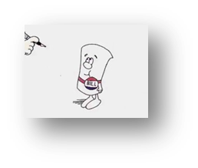
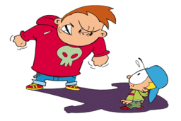
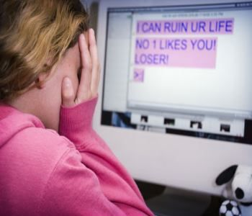
DASA Legislation
Dignity for All Students Act
Legislation 2012
Bullying, Harassment and Discrimination
Amended 2013
Cyberbullying

Slide 10
Covered Groups: NYS (11)
Race
Color
Weight
National Origin/Ethnicity
Religion
Religious Practice
Disability
Sexual Orientation
Gender
Gender Identity or Expression
Sex
Code of Conduct Issues
Other acts of bullying not covered under protected groups
Examples: poverty, being weird, different, tall, short, athletic, musical, etc.

Slide 11
Why Don’t Students Report Bullying?
Notes:
Brainstorm list

Slide 12
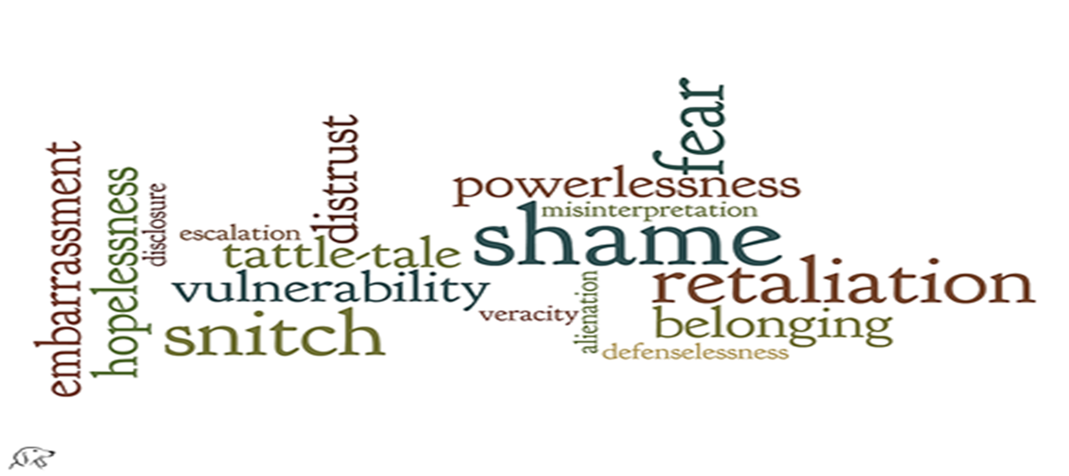
What Prevents Reporting?

Slide 13
Bystander to Advocate
Other people involved in Bullying
Skills students need?
Notes:
Brainstorm skills students need to report and why they may be afraid to report.

Slide 14
How to Report
Report to school (who?)
Say something
Report to police

Slide 15
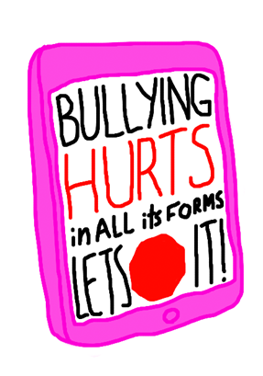
Helping Your Students
Speak up
Filter—Is it true?
Post less
Don’t over share
Practice
Develop coping skills
Expectations and limits
Work with school

Slide 16
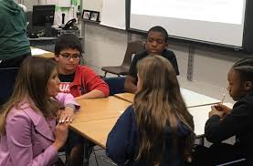
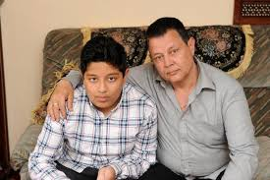
Resources for Helping Students
Notes:
See list of resources for parents online, brain storm additional resources

Slide 17
Questions
Questions not answered?

Slide 18
