Slide 1
EASY CBM
Testing online

Slide 2
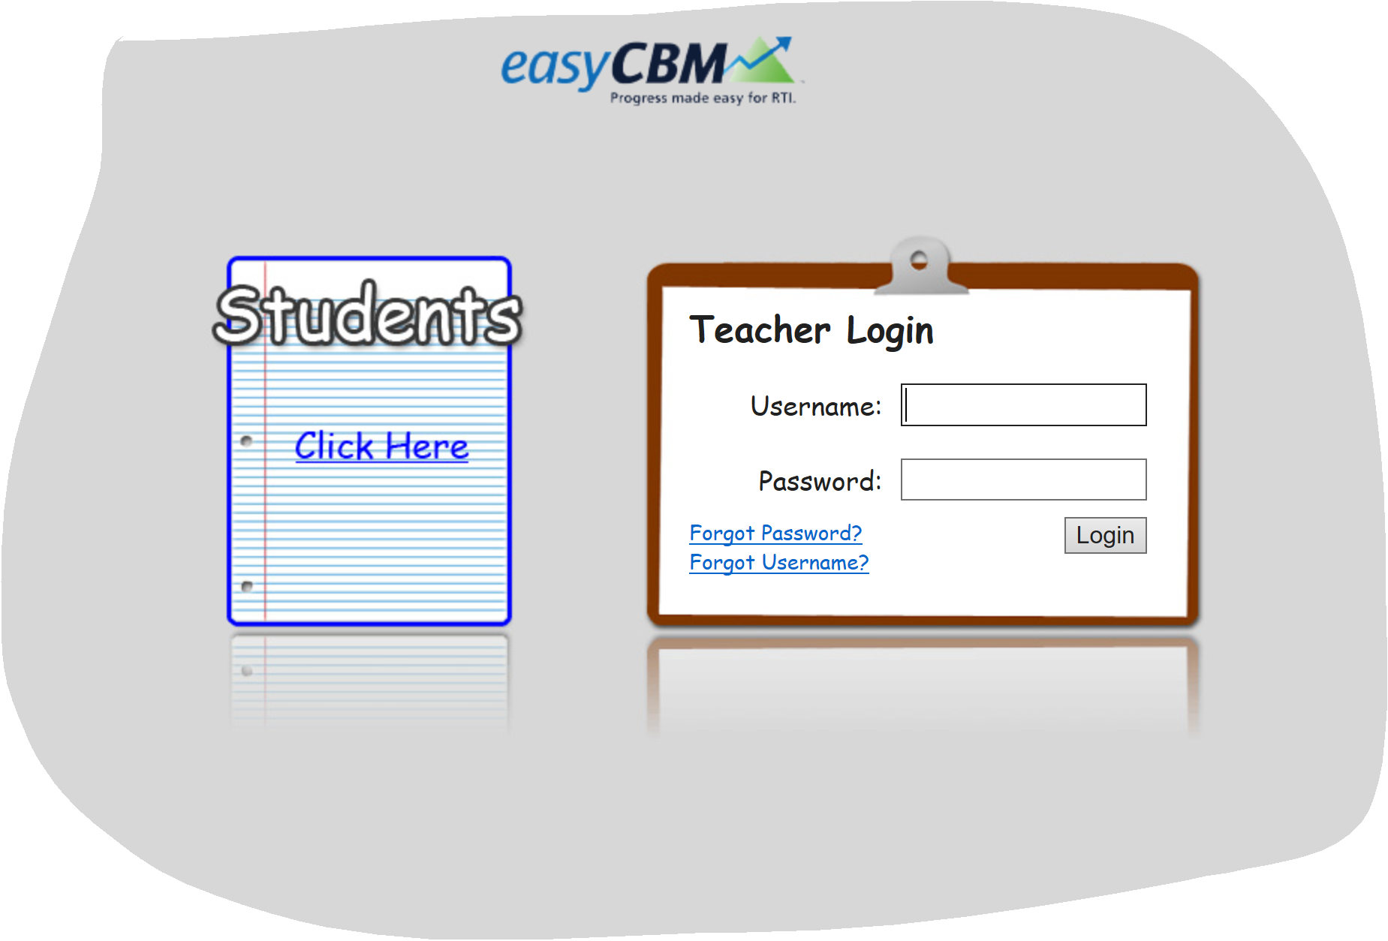
Easy CBM sign-in
http://mep.ny.easycbm.com
Notes:
You may see a message “this site is unsecure”. Click on details and go onto the website.

Slide 3
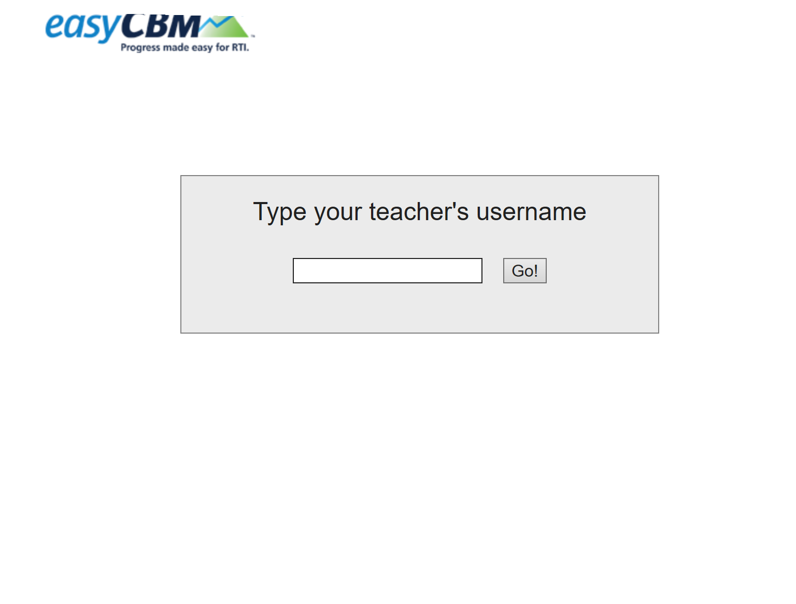
You will need to type in the tutor sign-in for Easy CBM in this box.
Example: lrivera then click on the Go! Button. Tutor has control of the computer, screen sharing questions and student gives verbal answer which tutor needs to click on the answer
This is where you will sign-in to start the online testing.

Slide 4
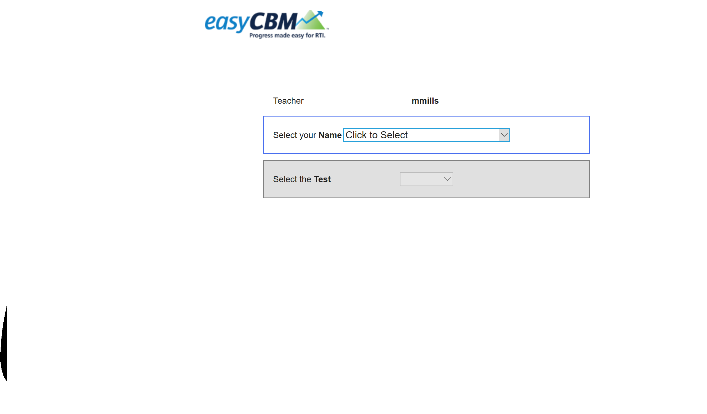
When you hit “Click to Select” a drop down menu will display all students that are assigned to you (the tutor). You will need to click on the name of the student you are testing.
This is where you select the test that the student is taking.
Please note that you will only select the CCSS Math or CCSS Reading, as these are the assessments we use.
Once you click on the test you will need to click on “Take Test” button.
Notes:
The Reading Fluency exam is not available online.

Slide 5
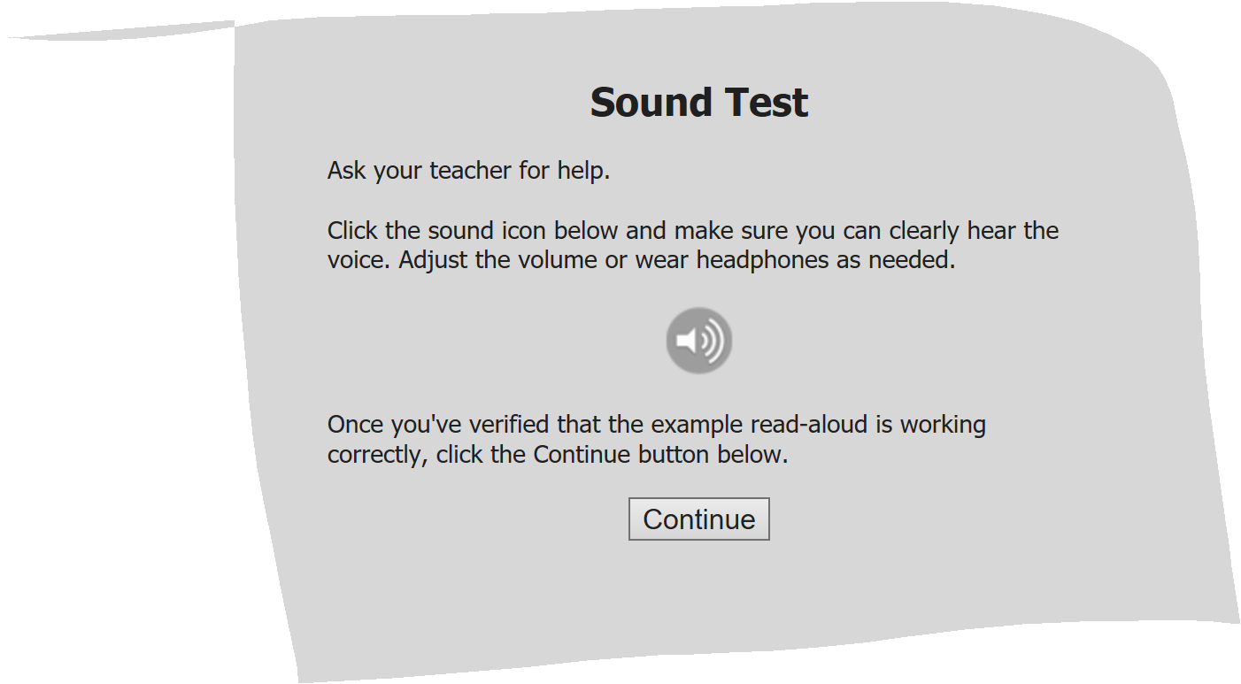
Sound Test: Please click on the continue button to check your sound on your computer. The computer will read the questions.
The sound will only work on the CCSS Math Exam in English or Spanish.
This screen will only come up if you have chosen the CCSS Math Exam.
Notes:
Add in here CCSS Math exam can be read to the student or use the computer reading for the student,

Slide 6
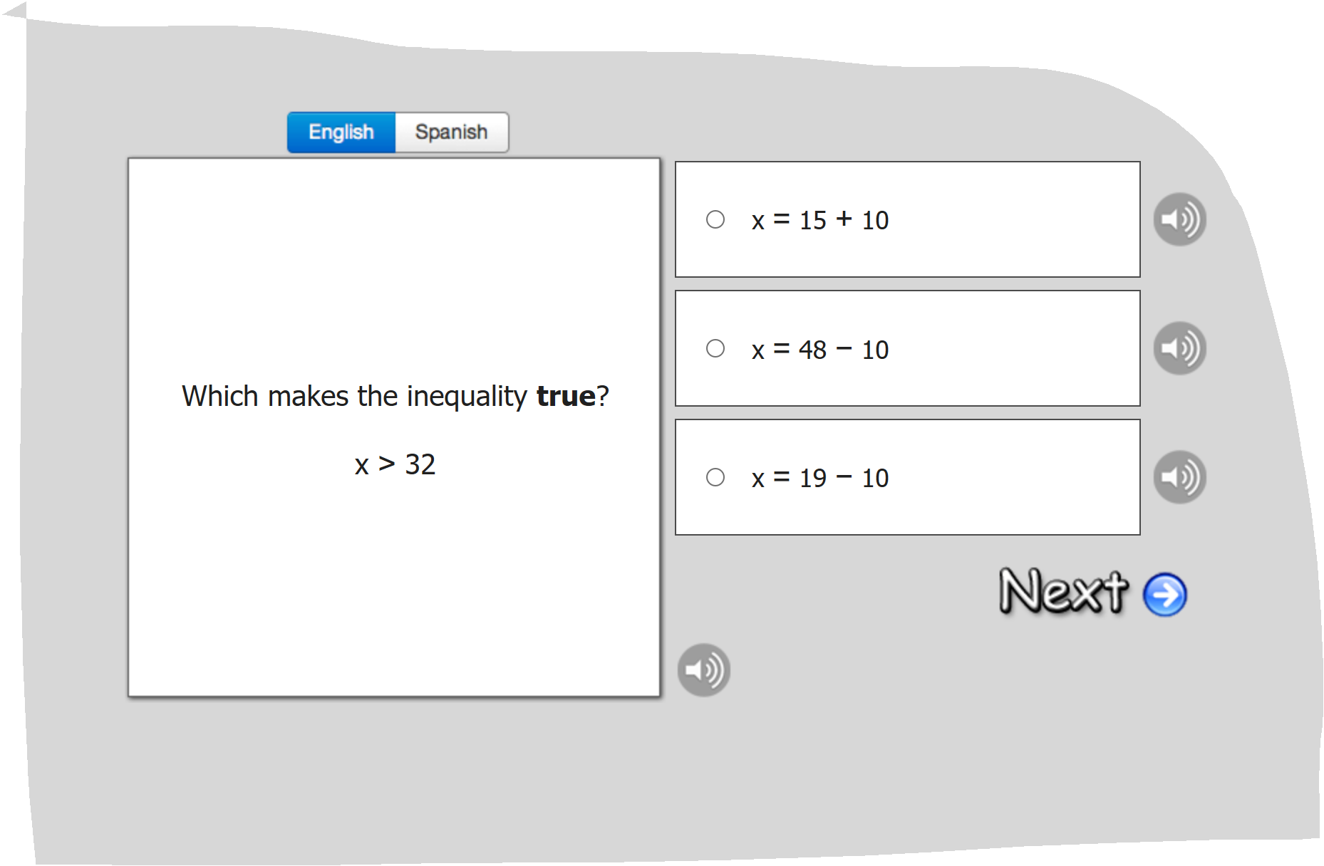
This is an example of a question on the CCSS Math assessment. Please note on the top you can choose English or Spanish. The computer will read the question to you (in English or Spanish) or you can choose to read the questions for CCSS Math only to the student.
The student can tell you the answer. The tutor will need to click the circle that the student chose. Tutor can check with student to ask “ is that your final answer?” and asks student to repeat final answer.
Notes:
You can not skip a question and go on. If student is struggling you can pause for the day. We recommend maximum of three sessions to complete testing.

Slide 7
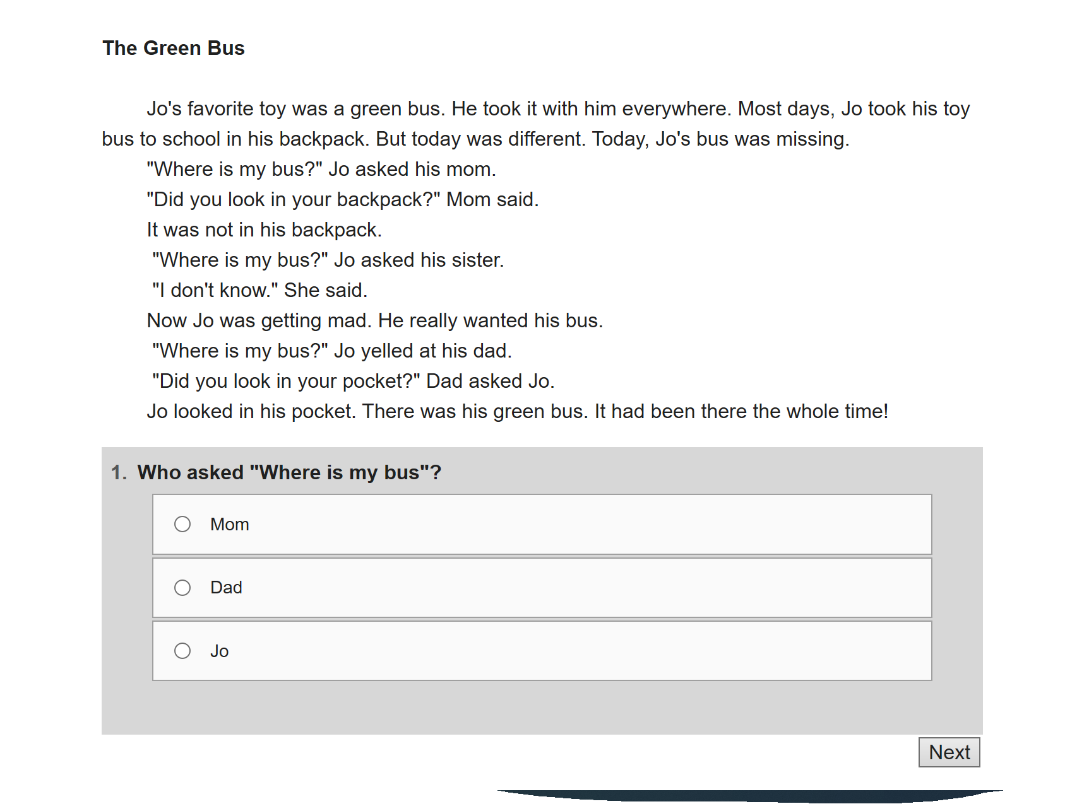
This is an example of the CCSS Reading Exam.
This exam requires the student to read the passage on “their own” and answer the questions. The tutor will need to screen share so that student can see the passage. The student can tell the tutor the answer and they can click on what student answered.
Notes:
If student has an IEP . Tutor can read the test to the student. If student can’t answer three questions in a row STOP the Exam!

Slide 8
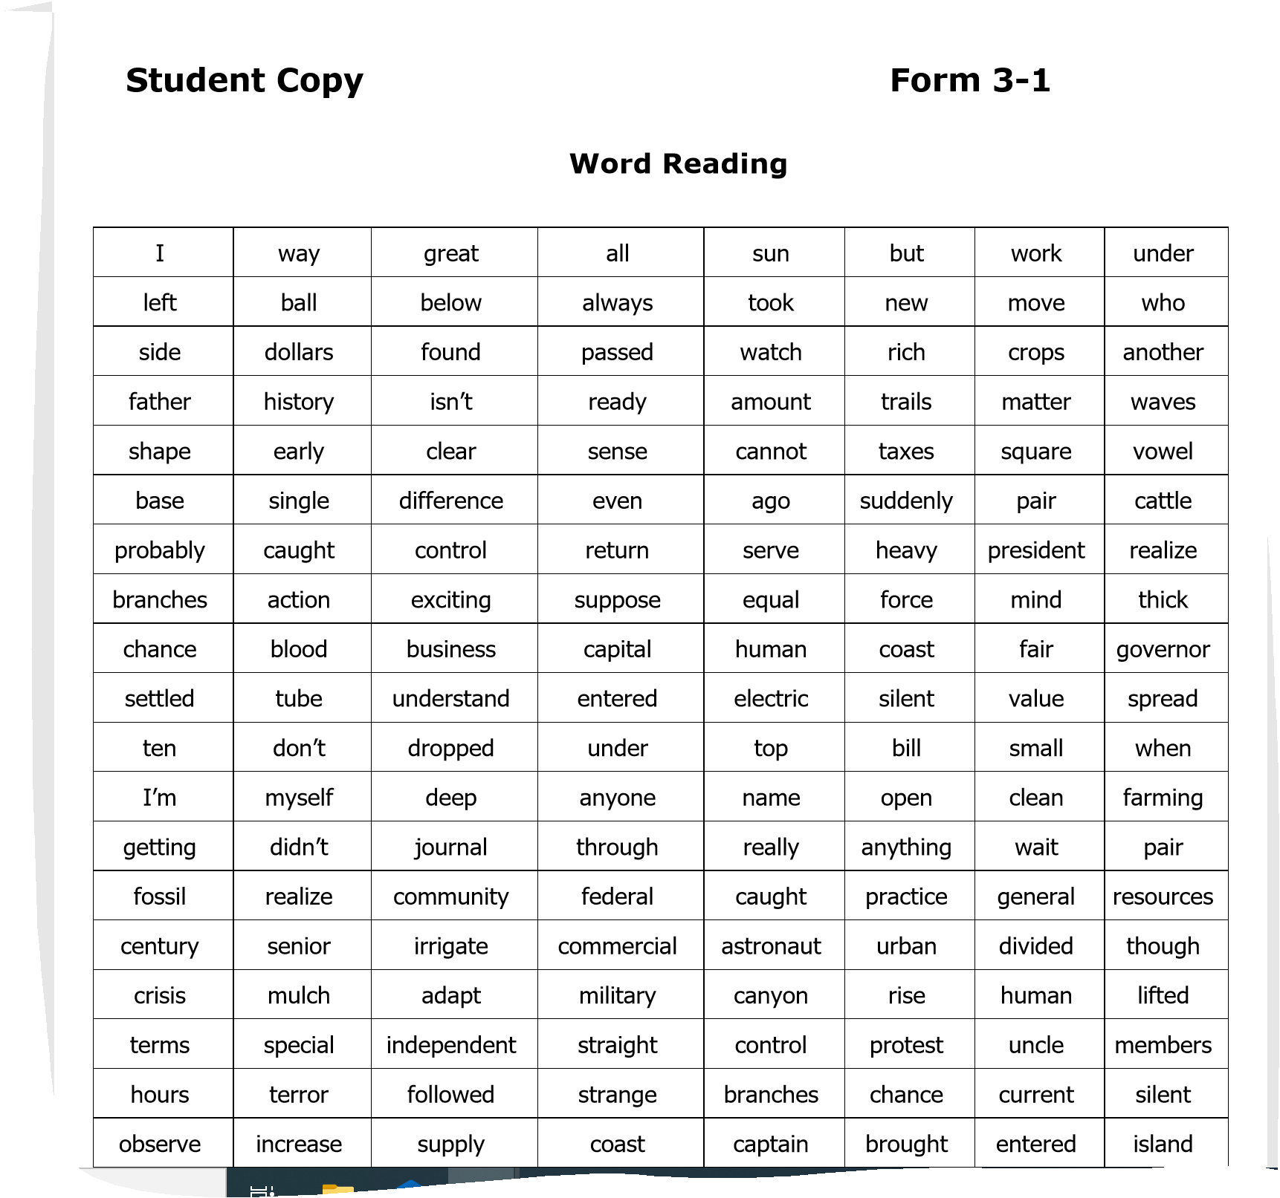
You will need to screen share the student copy of the Reading Word Fluency and have the student read to you. Read the directions on the Assessor copy to the student. Set the alarm on your phone for 60 seconds and when the alarm goes off please stop the test.

Slide 9
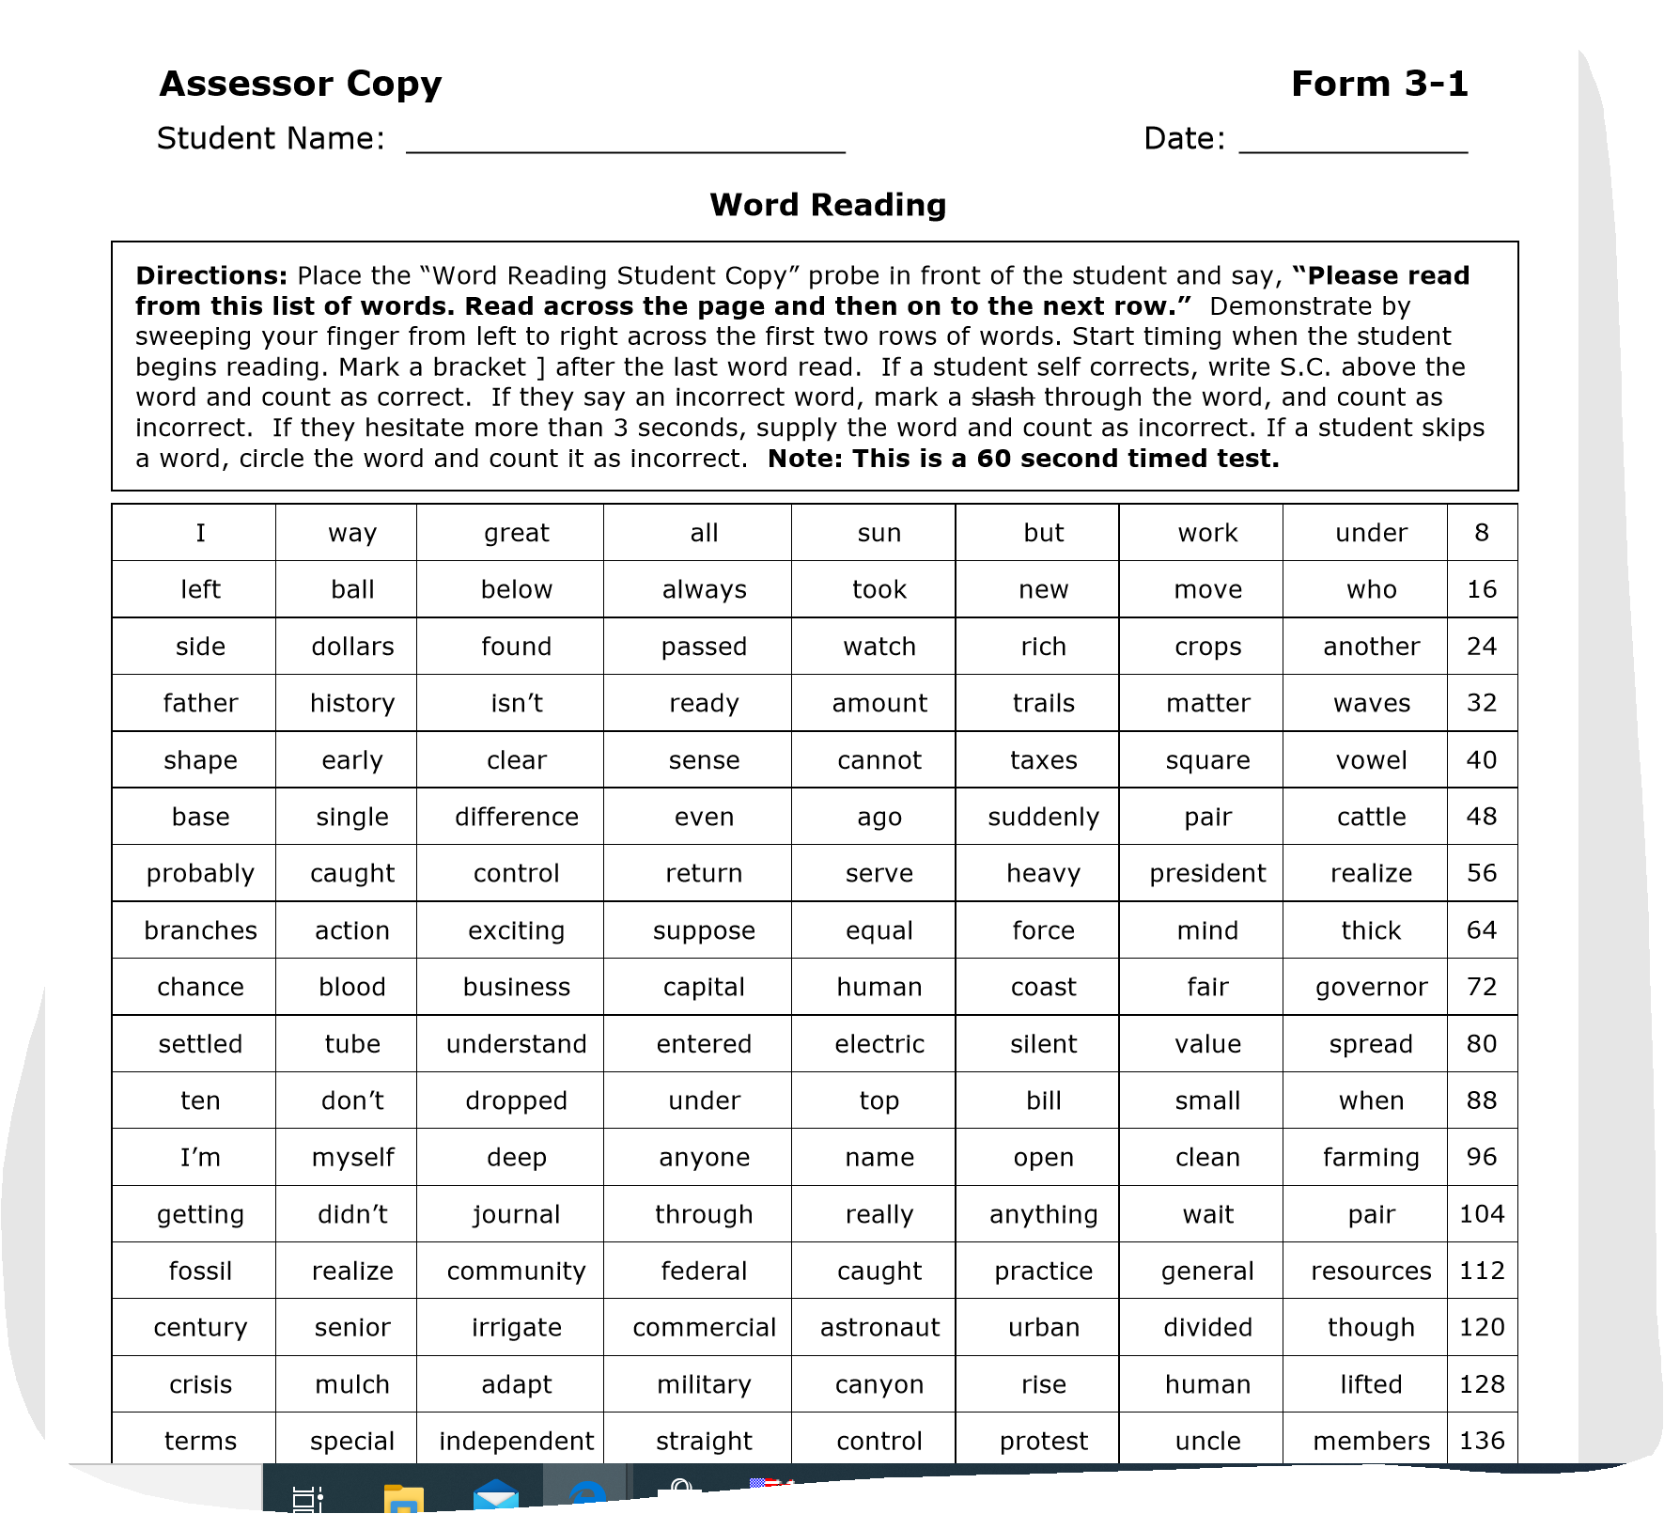
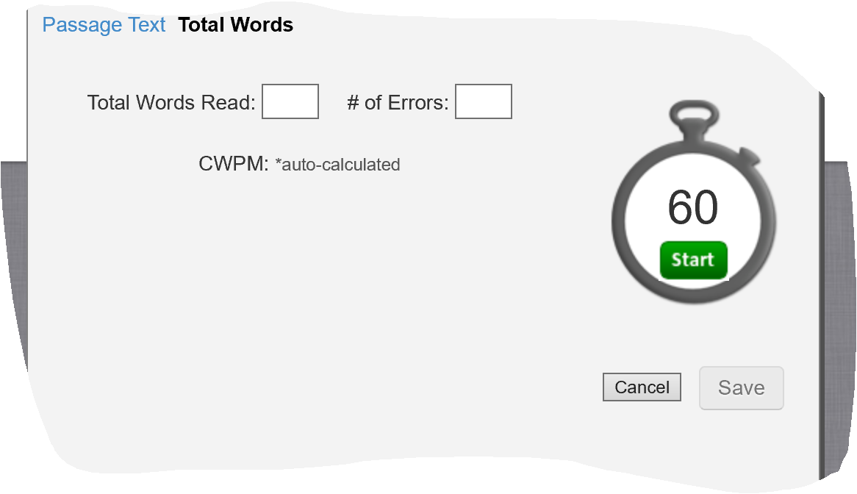
Have a copy of the Assessor Word Reading fluency printed to correct as the student is reading to you.
You (the tutor) will need to log into Easy CBM to enter the fluency scores for each designated student.
Notes:
Lisa will send Passage Reading Fluency exams (student copies and Assessor copies) to Director’s on August 17, 2020.

Slide 10
Student Lists
Students cannot be tested until Lisa has uploaded the student lists into Easy CBM first.
Lisa has worked with Directors to identify potential students. If you have recently made a student a Level 3 they may not appear in the list.
If you do not see a student listed please contact your Director so that they can be added.

Slide 11
Scenarios
If a student has only a phone and is visually impaired they are not a candidate for online testing for Easy CBM.
Speak to your Director if you have connectivity or hardware issues.
If you have questions about who should be tested please speak with your Director.

Slide 12
Easy CBM Online Testing Facts
You cannot test students until names have been uploaded into Easy CBM system.
You can exit out of any of the CCSS Reading and CCSS Math exams and it will automatically save where you left off. You can return later to finish the exam.
CCSS Reading and CCSS Math are automatically scored once the exam is completed. Tutors will not need to enter scores. The Passage Reading Fluency exam is not available to take online. Reading Fluency scores will need to be entered by the tutor.
The Passage Reading Fluency Exams “student and assessor” copies will be sent to Directors on August 17, 2020. These will be screen shared by tutors with the students reading off of the screen.
If a student is unable to answer questions then the tutor should exit out of the exam and revisit at a future session for a maximum of three attempts.
The online exams will not let you go to the next question without answering the current one, students will need to guess an answer to move on.

Slide 13
How to enter Passage Reading Fluency Scores on Easy CBM website
How to enter student fluency scores in easyCBM: Login to the easyCBM website. Click on "Measures" on top menu bar. Click on "Enter Fall Scores." Click on the name of your METS (i.e., "Brockport"), click the Grade of student (i.e. "Grade 3"), click on your name (the Teacher name!), "PRF" box (Passage Reading Fluency), Enter Total Words Read and Enter # of Errors in the corresponding box. Click Save.

Slide 14
Easy CBM Online Testing Facts
You are encouraged, but not required, to administer the easyCBM ELA and Math Fall and Winter Benchmark Assessments (pre-tests) to those students determined to be Entering, Emerging, Transitioning on the NYSITELL, NYSESLAT, or equivalent assessments.
If you do not administer the easyCBM ELA and Math Fall or Winter Benchmark Assessments (pre-tests), please enter a “zero” (0) as their score on the easyCBM ELA and Math Fall or Winter Benchmark Assessments (pre-tests).
You are required to administer the easyCBM ELA or Math Spring Benchmark Assessment (post-test).
You are required to administer the easyCBM ELA and Math Fall and Winter Benchmark Assessments (pre-tests) to those students determined to be Expanding and Commanding on the NYSITELL, NYSESLAT, or equivalent assessments. For these students, you may stop after three attempts on the assessment where appropriate, and enter a “zero” (0) as their score on the easyCBM ELA and Math Fall and Winter Benchmark Assessments (pre-tests).
You are required to administer the easyCBM ELA or Math Spring Benchmark Assessment (post-test).

